Slide 1
Predicting suitable location for Indian Restaurants in New York

Slide 2

Topics
Problem
Data
Method
Cleaning Data
Data Visualisation
Results

Slide 3
PROBLEM
Find out Areas with Indian Restaurants
Find out Area with a great potential of having more Indian Restaurants
Areas Preferable for having Indian Restaurants

Slide 4
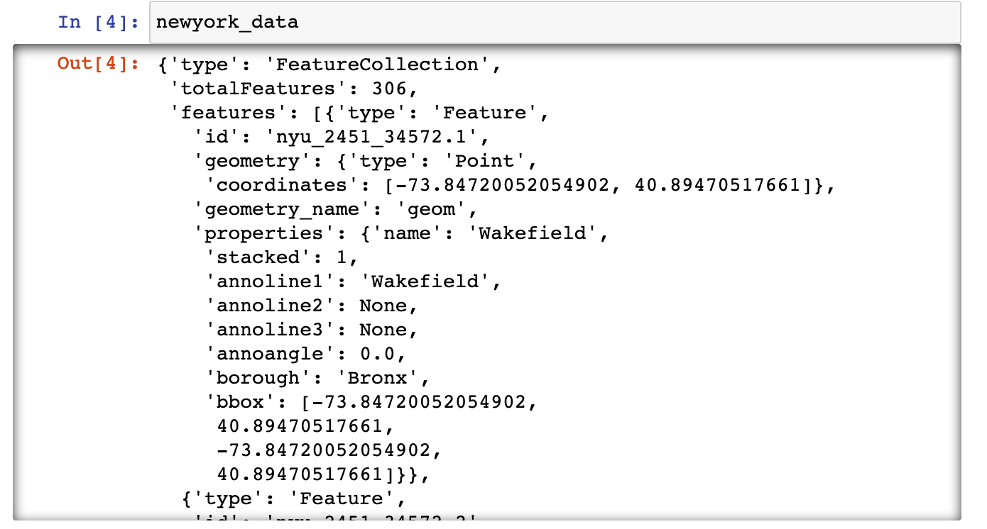
Data
New York Dataset (https://cocl.us/new_york_dataset)
This dataset has all boroughs and neighbourhoods of New York City
Geospace data(in github)

Slide 5
Approach / Method
We collect all data from the dataset by web scraping tools or download the data from the site in json format and perform all operations to convert it into a data frame.
We find out all Indian restaurants in New York by using Foursquare API.
Then get all the details about the restaurants like ratings, tips and likes.
Use the pandas functions to get mean of all ratings and likes and find out the places where people are liking Indian cuisine the most
Sort the data and create maps of it.

Slide 6
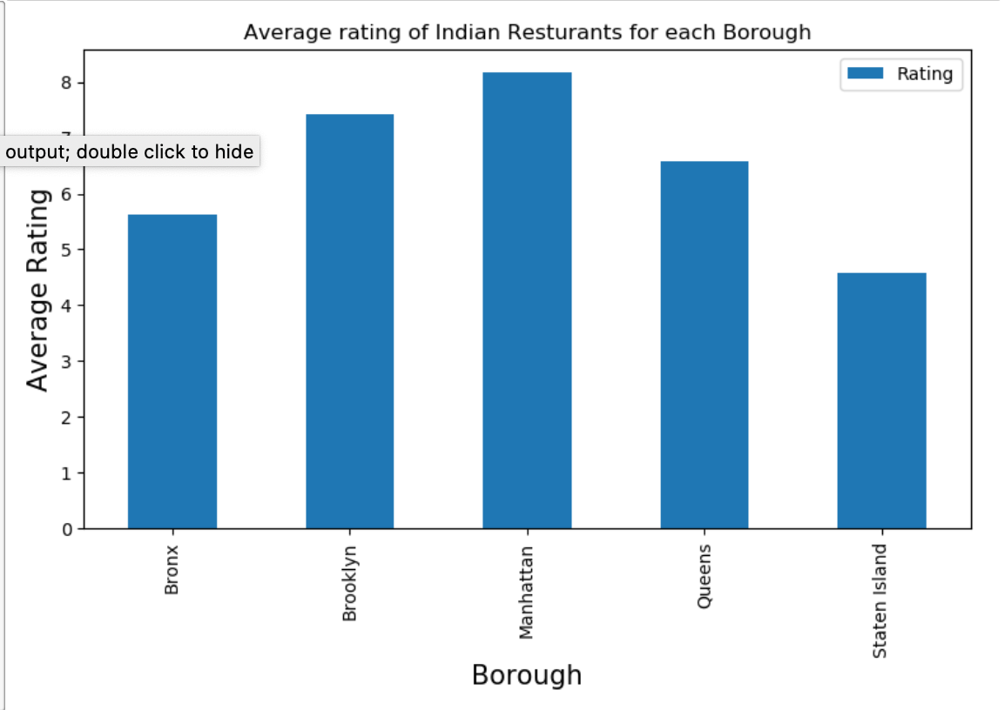
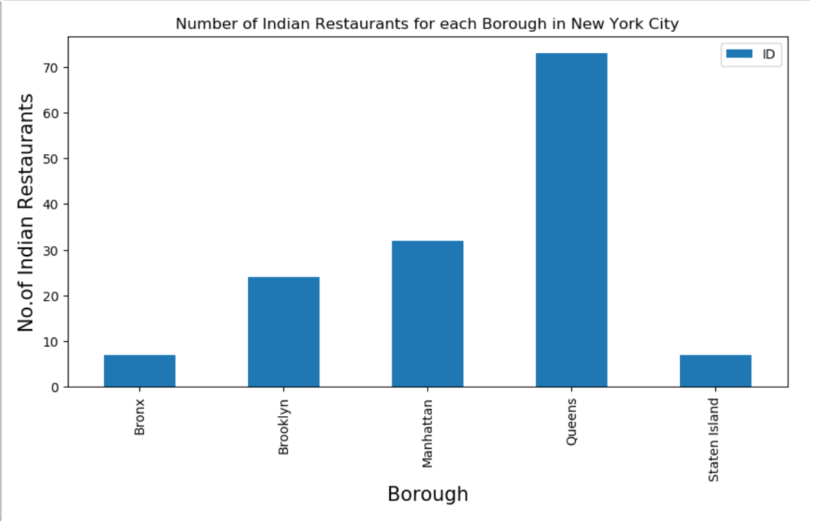
Visualisation
Create bar charts, count plots, folium maps , chloropeth maps using folium library, pandas in-built visualisation, Matplotlib,seaborn libraries.

Slide 7
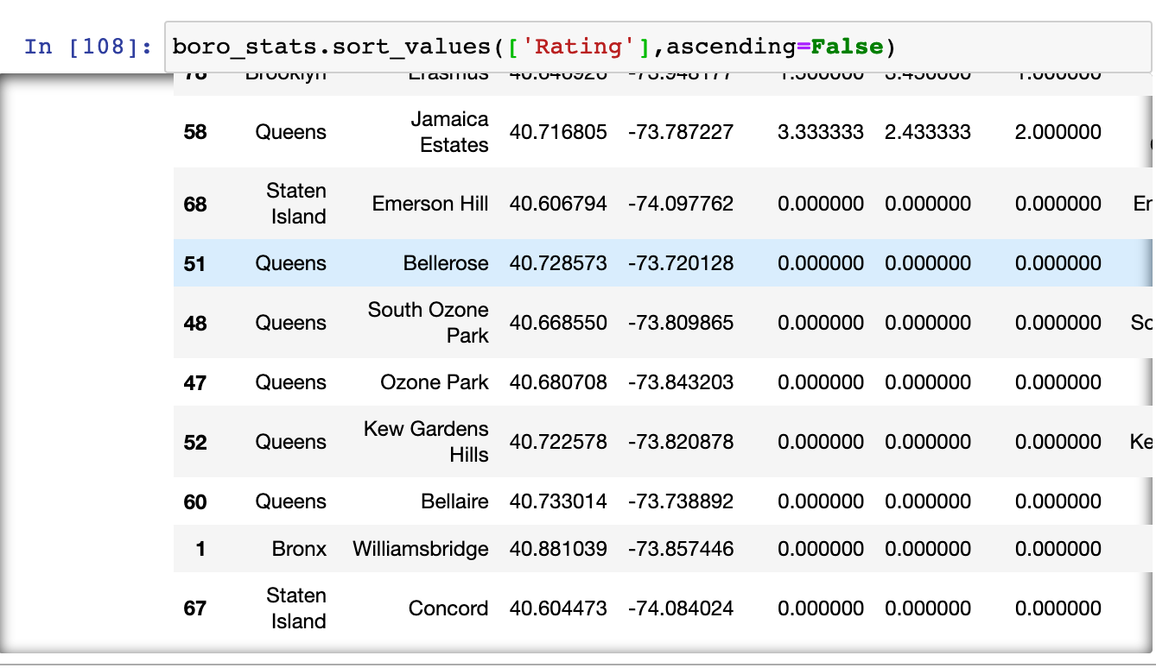
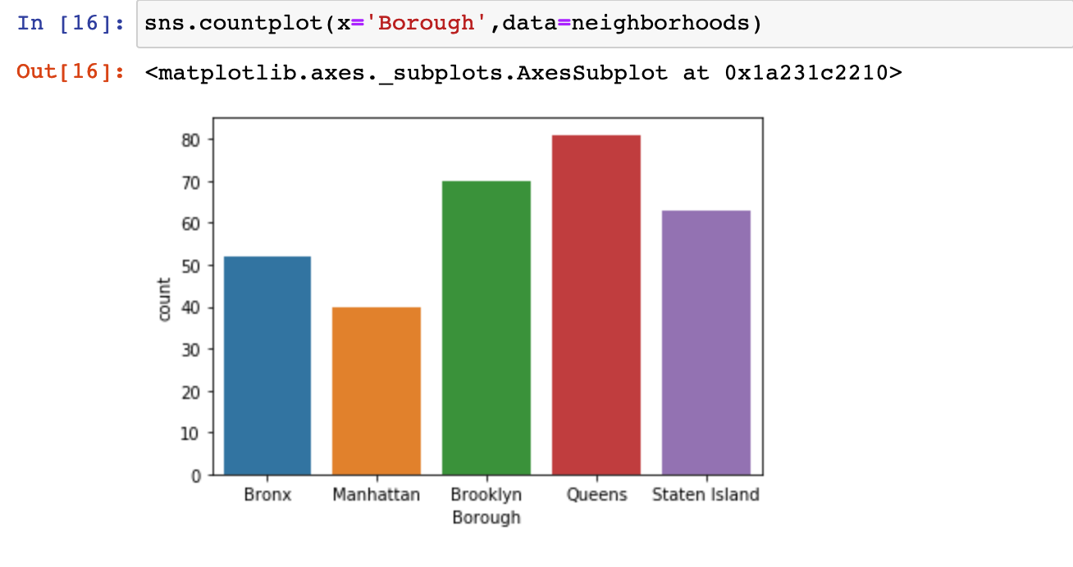
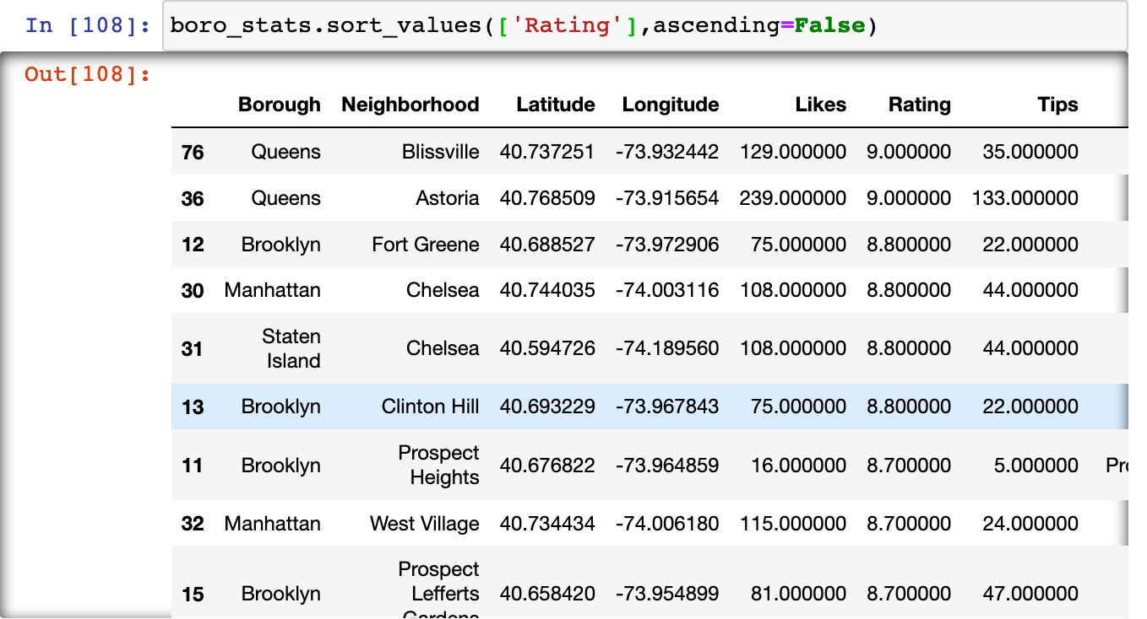

Slide 8
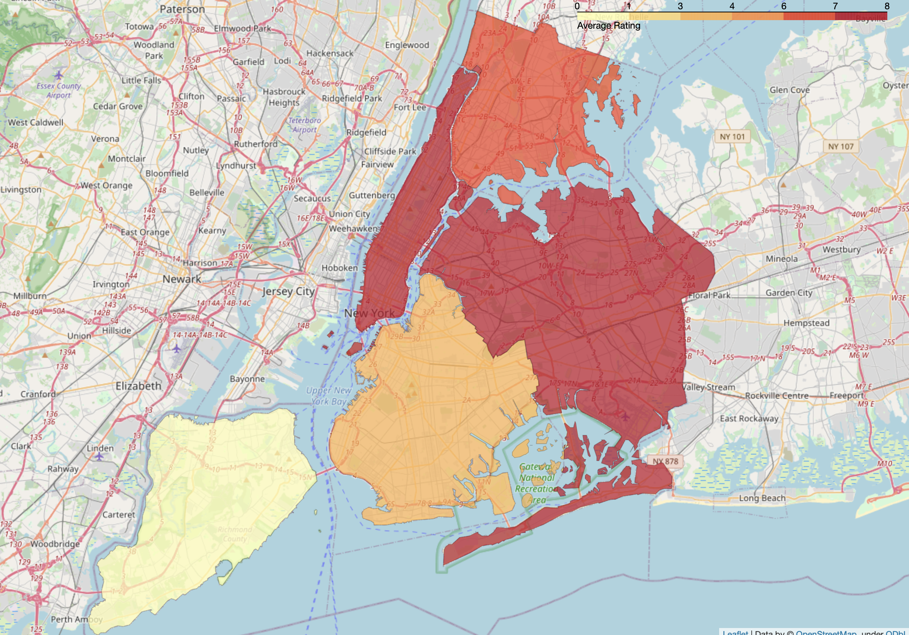
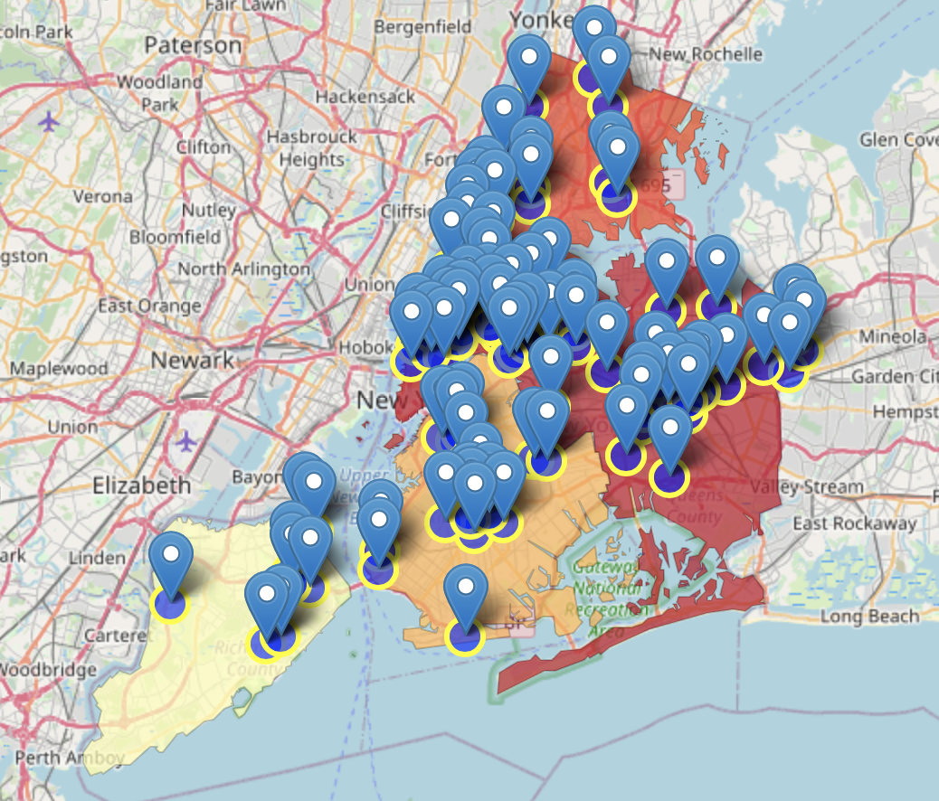

Slide 9
Results
Queens,Brooklyn and Manhattan are top in user ratings.
Manhattan has highest ratings and likes for Indian restaurants hence has a good potential for setting new restaurants.
Staten Islands have the least average user rating
Manhattan, Queens are best boroughs to live for having Indian Food.

